Slide 1
Machine Learning - Introduction
Representation
How to get feature vectors out of raw data
(Source: https://developers.google.com/machine-learning/crash-course/representation/qualities-of-good-features

Slide 2
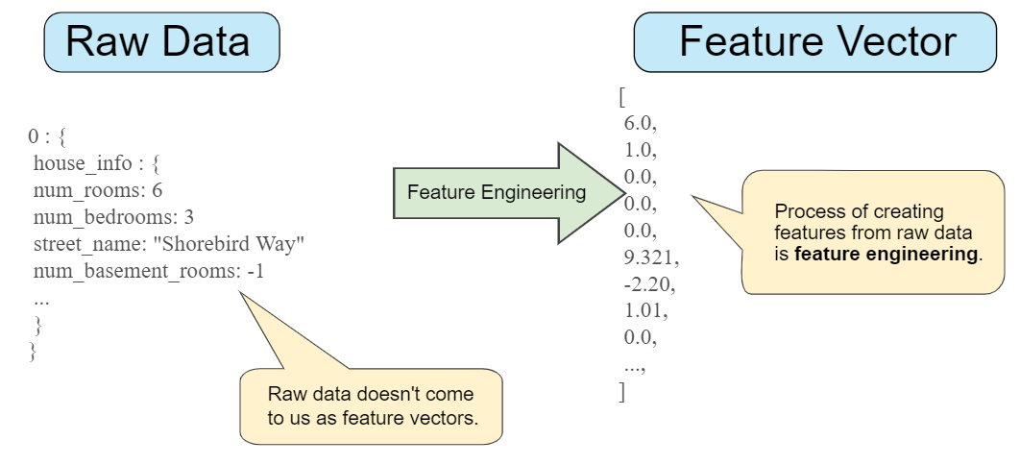
Feature Engineering: Mapping Raw Data to Features

Slide 3
Mapping Categorical Values
Categorical features have a discrete (finite) set of possible values. For example, there might be a feature called faculty with options that include:
Simple Solution:
{‘Betriebswirtschaft’, ‘Soziale Arbeit’, ‘Informatik’, ‘Maschinenbau’, ‘E-Technik’}
{ 0 , 1 , 2 , 3 , 4 }
Raw Data
Feature
faculty: „Betriebswirtschaft”
Feat. Engin.
0
Problems
How to deal with multiple values?
Impact of values in a (pseudo)-linear Model?

Slide 4










Mapping Categorical Values: One Hot Encoding
Raw Data
Feature
faculty: „Betriebswirtschaft”
Feat. Engin.
[1, 0 , 0 , 0 , 0]
Feat. Engin.
faculty: „Informatik”
[0, 0 , 1 , 0 , 0]
{‘Betriebswirtschaft’, ‘Soziale Arbeit’, ‘Informatik’, ‘Maschinenbau’, ‘E-Technik’}

Slide 5
Tips for good features
Avoid rarely used discrete feature values
Clear and obvious meanings
Don't mix "magic" values with actual data
Account for upstream instability

Slide 6
Cleaning feature values: Know your data
Cleaning („Scrubbing“), i.e.
handle missing values
remove duplicate examples
remove false labels
Outlier Handling (Logarithmic Scaling)
Binning (if there is obviosuly no linear relationship)
Scaling

